Slide 1
Effective Conflict Management
Dr. Michele Paludi, Matthew Baird, MSM,
Dr. Gary Stroud and Dr. Garry McDaniel
January 22, 2021
Notes:
Michele will welcome attendees and announce topic

Slide 2
CONFLICT MANAGEMENT
This webinar is designed for informational purposes only and does not constitute legal advice. Any action or inaction by the viewer based on the information provided is done without guarantee of its accuracy or suitability for a particular purpose.
Notes:
MICHELE

Slide 3
MEET THE EXPERT PANEL
Matthew Baird, MSM
Dr. Gary Stroud
Dr. Garry McDaniel
Dr. Michele Paludi
Notes:
MICHELE INTRODUCES EACH PANEL MEMBER; PANEL MEMBER BRIEFLY DESCRIBES THEIR EXPERTISE/courses

Slide 4
AGENDA
Welcome and introductions
Overview of webinar
Conflict management
Graduate business courses addressing conflict management
New book!
General discussion
Notes:
Michele

Slide 5
CONFLICT MANAGEMENT
81% of workers experience conflict with others
U.S. employees spend 2.8 hours per week dealing with conflict
The typical manager spends 25–40% of time managing conflict
Notes:
Michele

Slide 6
NEGATIVE CONFLICT STYLES
FIRECRACKER: SUDDEN ANGER
COLD SHOULDER: WHO CAN HOLD OUT THE LONGEST
BACKSTABBING: POSITIVE TO ONES FACE ONLY
Notes:
Michele

Slide 7
NEGATIVE CONFLICT
SOCIAL ZINGER: INSULTS IN FRONT OF OTHERS
TRIVIA FIGHTS: REAL ISSUES NOT ADDRESSED
TAKING THE LAST WORD: MUST “WIN”
Notes:
Michele

Slide 8
ORGANIZATIONAL CONFLICT
Change in Leadership
Change in Work
Conflicting Goals & Objectives
Limited Resources
Domino Effect
Notes:
Michele

Slide 9
OUTCOMES OF CONFLICT
Climate of distrust
Resistance to cooperation
Stress
Missed deadlines
Decision-making suffers
Inefficient use of resources
Attrition
Notes:
Michele

Slide 10
CAN CONFLICT BE BENEFICIAL?
Open dialogue
Commitment to the organization
Increased efficiency and productivity
New approaches or solutions
Long-standing problems brought out into the open
Notes:
Michele

Slide 11
MISTAKES BY MANAGERS
Ignoring the situation
Most common response – It will only get worse
Conflict seldom resolves on its own
Becoming aggressive “In your face”
Notes:
Michele

Slide 12
HOW TO DEAL WITH CONFLICT
SET UP AND MAINTAIN AN EFFECTIVE ATMOSPHERE
CLARIFY PERSPECTIVES
INDIVIDUAL & SHARED NEEDS
FOCUS ON THE FUTURE, NOT THE PAST
Notes:
Michele

Slide 13
CONFLICT MANAGEMENT DISCUSSED IN COURSES
Labor Relations and Conflict Resolution
Conflict Management
Leading Teams
Notes:
Michele

Slide 14
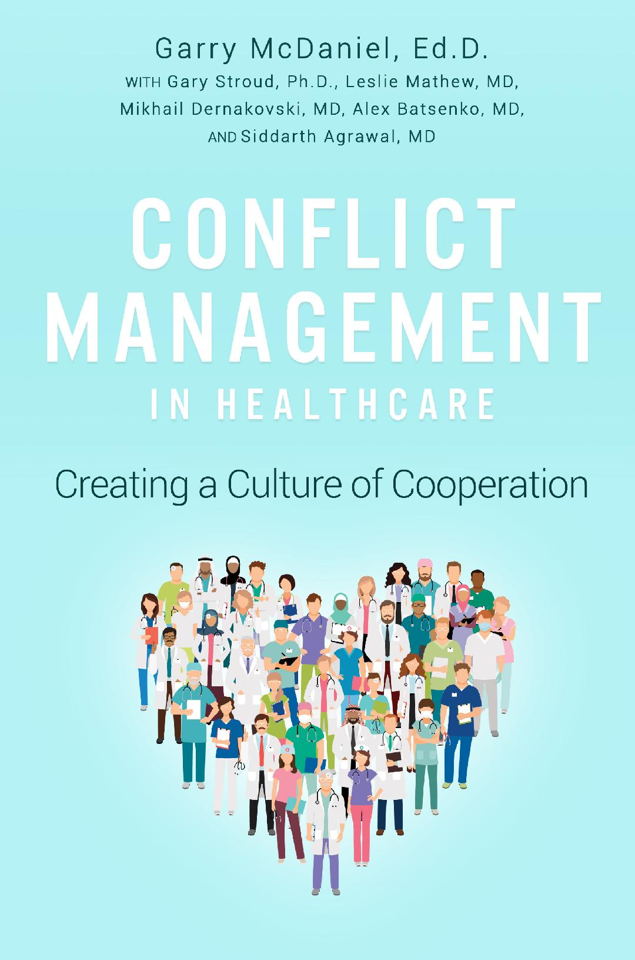
MEET THE AUTHORS
NEW BOOK ON CONFLICT MANAGEMENT
Dr. Gary Stroud
Dr. Garry McDaniel
Notes:
Gary and Garry

Slide 15
QUESTIONS COMMENTS

Slide 16
THANK YOU
Michele Paludi, Ph.D.
Senior Faculty Program Director
School of Graduate Studies
Excelsior College
7 Columbia Circle
Albany, New York 12203
mpaludi@excelsior.edu
Notes:
MICHELE

